Slide 1
VPN CONNECTION IN PACKET TRACER EXPLAINED STEP-BY-STEP
PREPARED BY:
SUCHANDA MUKHERJEE

Slide 2
WHAT IS VIRTUAL PRIVATE NETWORK (VPN)
A VPN is a secure and encrypted connection that can be thought of as a tunnel.
VPN is created by establishing virtual point to point connection, mainly through use of virtual tunneling protocols , or traffic encryption.
VPN provides the following features:
A) Confidentiality
B) Integrity
C) Authentication
VPN has two phases:
IKE Phase 1
IKE Phase 2

Slide 3
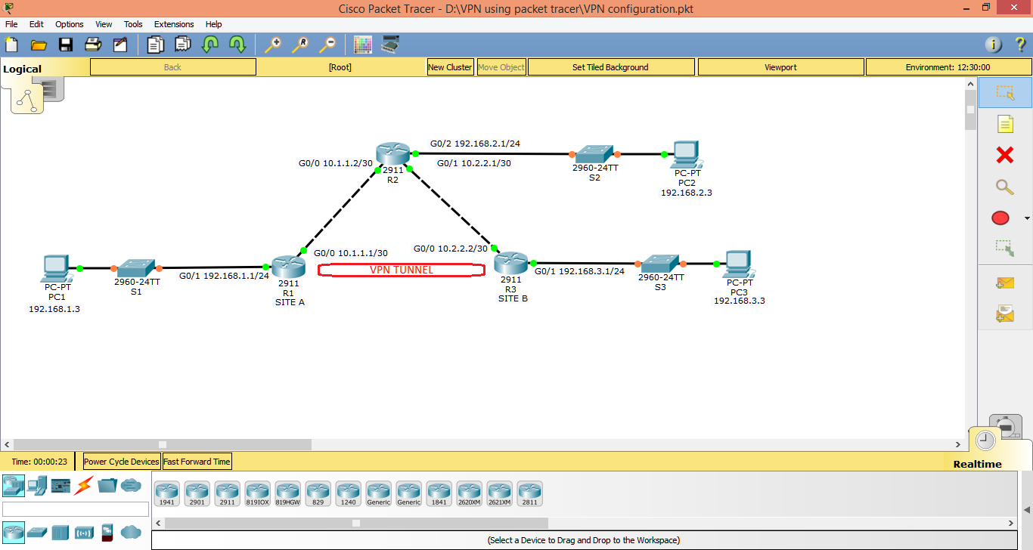
Network Diagram:

Slide 4
Circuit Description:
R1(Site A)
Interface G0/0 10.1.1.1/30
Interface G0/1 192.168.1.1/24
R2
Interface G0/0 10.1.1.2/30
Interface G0/1 10.2.2.1/30
Interface G0/2 192.168.2.1/24
R3 (Site B)
Interface G0/0 10.2.2.2/30
Interface G0/1 192.168.3.1/24
PC-A : 192.168.1.3/24
PC-B : 192.168.2.3/24
PC-C : 192.168.3.3/24

Slide 5
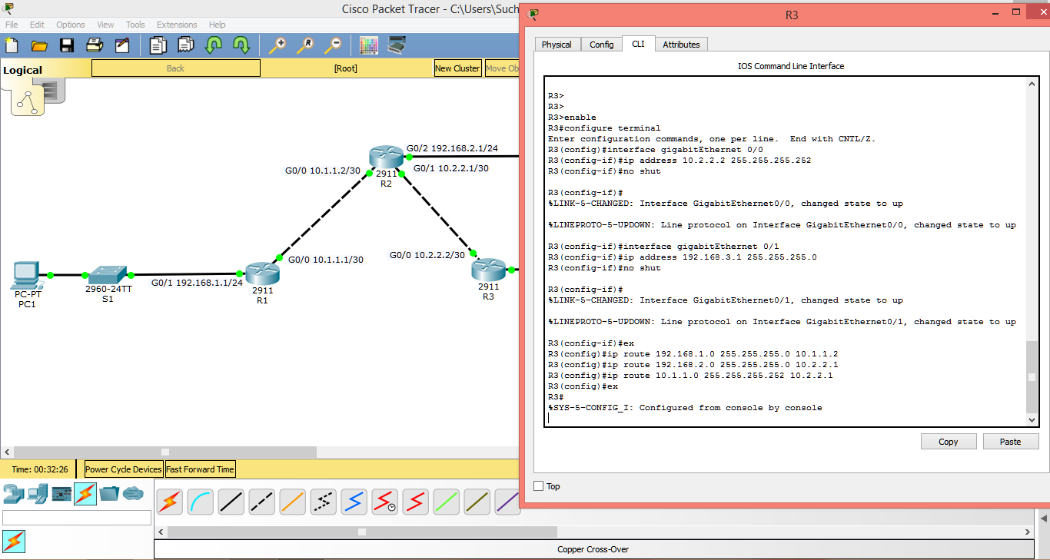
Router Configuration:

Slide 6
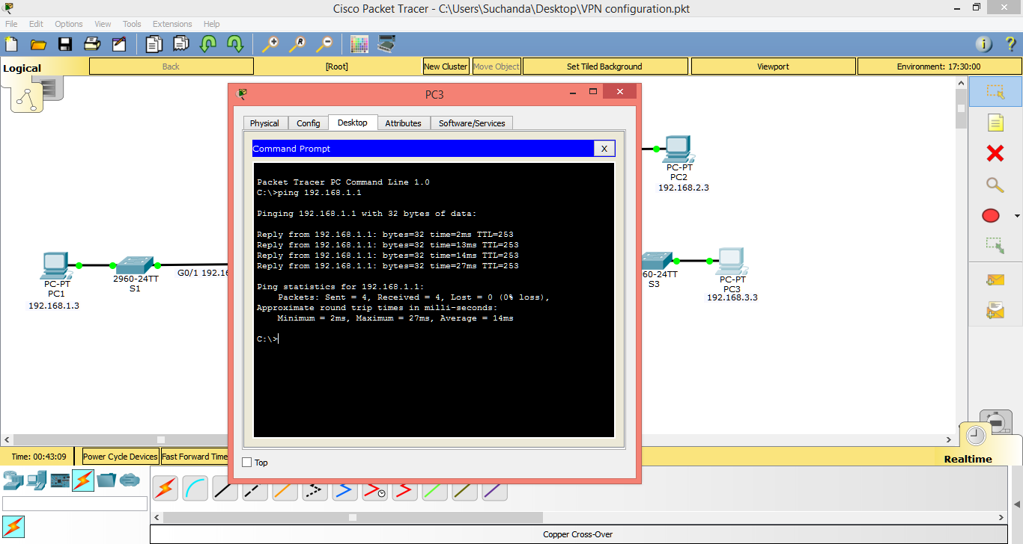
Testing Connectivity:

Slide 7
Phase 1 Policy Parameters:
PARAMETERS |  | R1 | R3
Key Distribution Method | Manual or ISAKMP | ISAKMP | ISAKMP
Encryption Algorithm | AES, DES or 3DES | AES | AES
Hash Algorithm | MD5 or SHA-1 | SHA-1 | SHA-1
Key Exchange | Diffie-Hellman 1, 2 or 5 | DH 2 | DH 2
Authentication Method | Pre-shared keys or RSA | Pre-share | Pre-share

Slide 8
Phase 2 Policy Parameters:
PARAMETERS | R1 | R3
Transform Set | VPN-SET | VPN-SET
Peer Hostname | R3 | R1
Peer IP Address | 10.2.2.2 | 10.1.1.1
Network to be Encrypted | 192.168.1.0/24 | 192.168.3.0/24
Crypto Map name | VPN-MAP | VPN-MAP
SA-Establishment | ipsec-isakmp | ipsec-isakmp

Slide 9
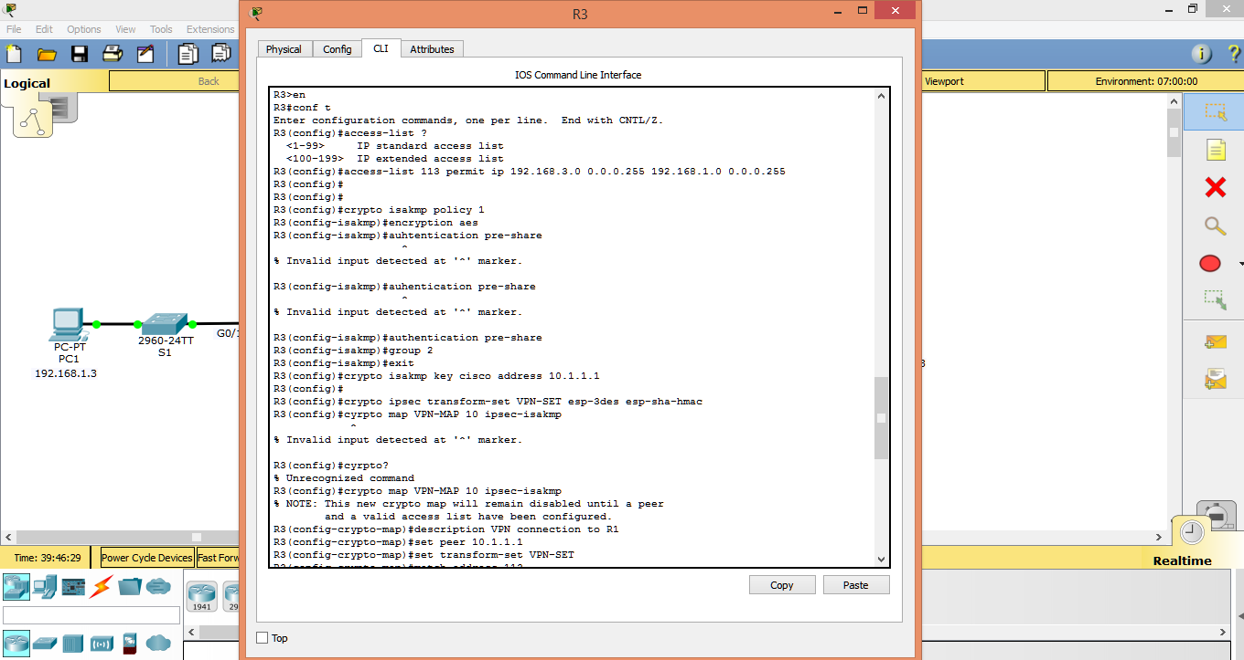
VPN Tunnel Configuration:

Slide 10
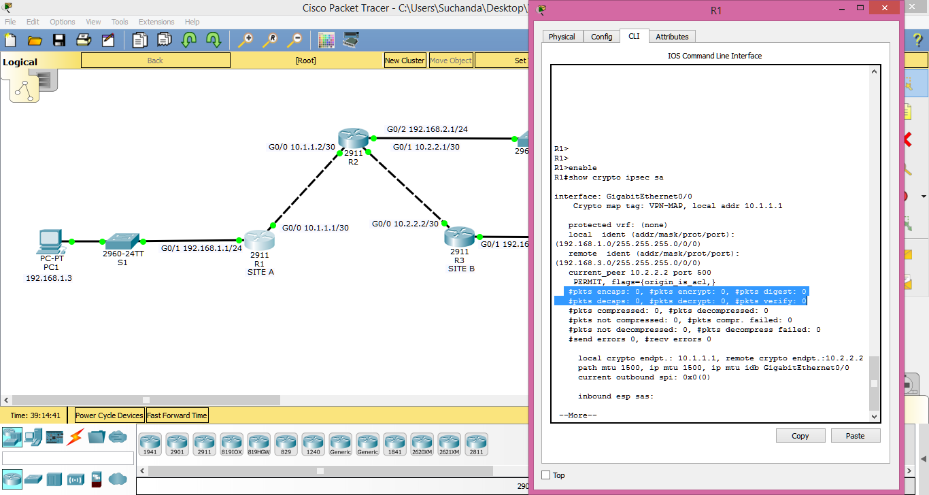
VPN Tunnel Verification:

Slide 11
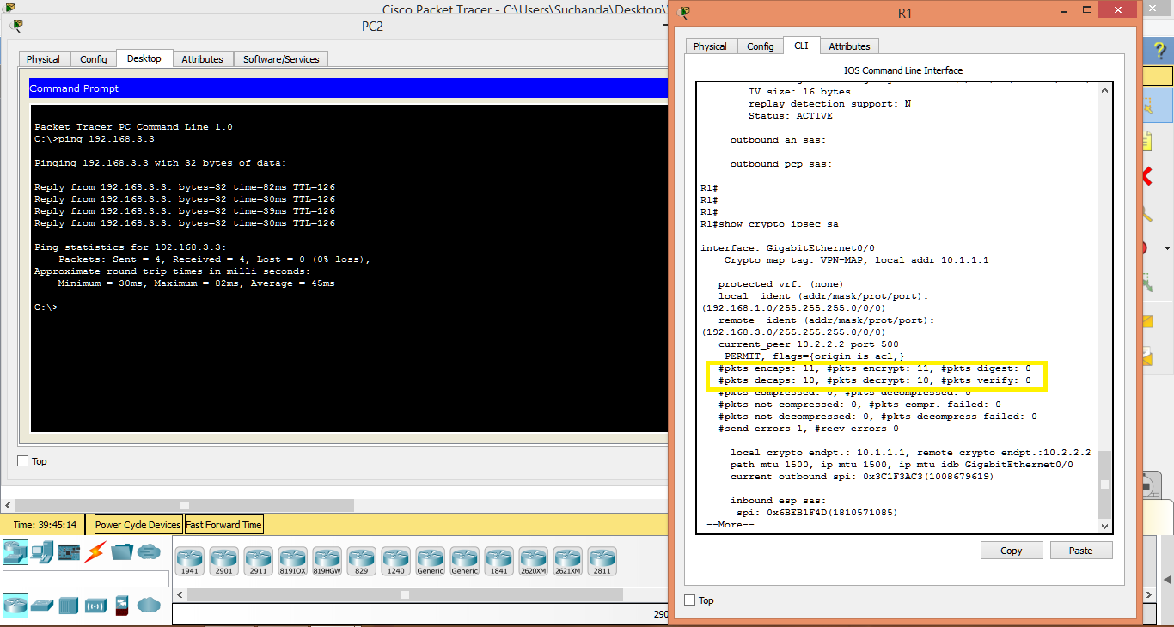
VPN Tunnel Configuration:

